Slide 1
Evidence: what is it, who needs it, and what are we doing about it?
Marcus C. Chibucos, Ph.D.
Slides for Evidence discussion,
OBI 2011 Philadelphia

Slide 2
Outline of topics
Brief overview
Evidence Ontology (EO) origins & development
Clarifying the meaning of evidence within EO
Conflating concepts
Two root classes
Modeling evidence
Progress since ICBO
OBI output as input to EO
Recent meeting with Chris, Jie & Marcus
Community needs
Midori Harris of PomBase
General goals
FYI
Quality codes workshop at Biocuration meeting
Acknowledgements

Slide 3
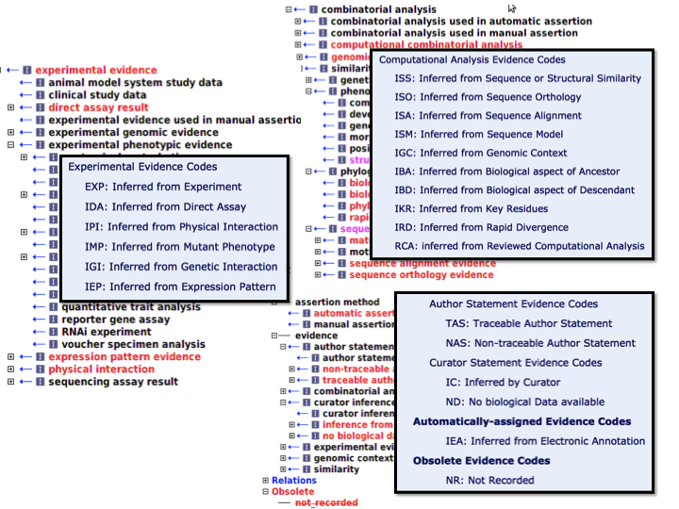
Origins of EO in Gene Ontology
GO codes are subset of EO terms:
“Note that these evidence codes are intended for use in conjunction with GO terms, and should not be considered in isolation from the terms.”
– Michael Ashburner, 2003

Slide 4
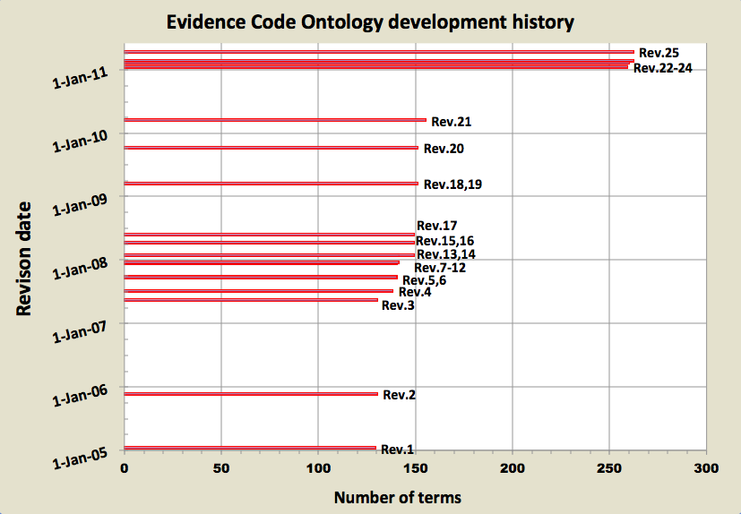
History of ECO revisions
http://obo.cvs.sourceforge.net/viewvc/obo/obo/ontology/evidence_code.obo?view=log
New evidence types & “assertion method” terms
254 terms
74% defined
M. Chibucos M. Giglio
S. Rhee ≈ 100 evidence descriptions (TAIR ca. 2001)
Saved by / committed by (from SourceForge)
M. Ashburner, S. Lewis, others?
[A. Ireland]
[C.Mungall]
127 terms
41% defined

Slide 5
2009 OBO Foundry review of EO rev. 19
Inconsistent mixing of is_a relations based on experimental methodology, commercial platform, types of reagents used, measurement objective, and analyte being measured
Lack of definitions for many terms or definitions as elucidation
Lack of active development and web presence, e.g. metadata
Lack of interoperability with and yet overlap of OBI

Slide 6
EO development 2010-2011
General ontology structure improvement
Term cleanup (naming, spelling, etc.)
Definitions, starting by defining “evidence”
“A type of information that is used to support an assertion.”
Simultaneously addressing numerous user requests
Teasing apart what ECO is attempting to represent
Subsequent creation of a second root class
Guiding term development & extending ECO with Ontology for Biomedical Investigations

Slide 7
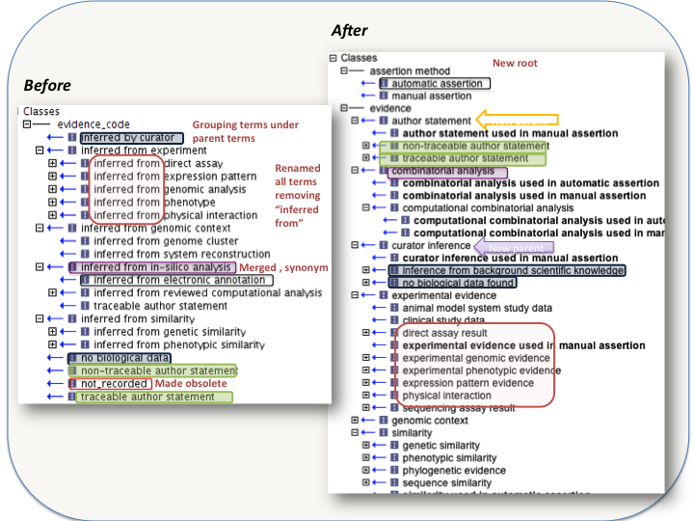
Initial EO improvements

Slide 8
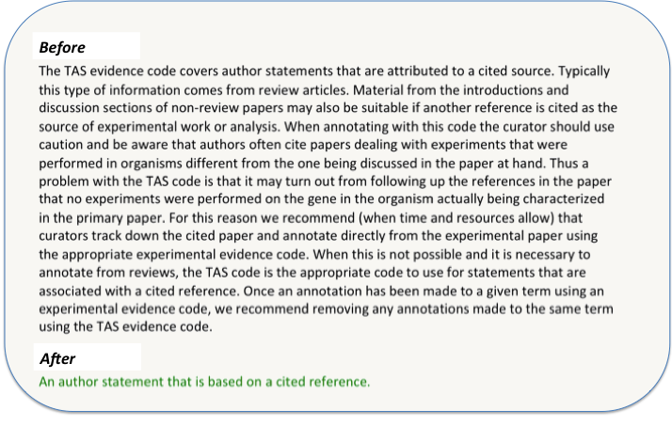
Definition updates – Aristotelian & GO removal

Slide 9
Clarifying the meaning of evidence
Previously mixed concepts due to ad hoc development:
Origin of evidence
type of assay or analysis generating data
Type of information giving rise to evidence
piece of data or result of a data analysis
Evaluation or assessment yielding evidence
data analysis culminating in evidence
Assignment of evidence in an annotation
performed by a human or a machine
Inference drawn from evidence
a conclusion arrived at after weighing evidence

Slide 10
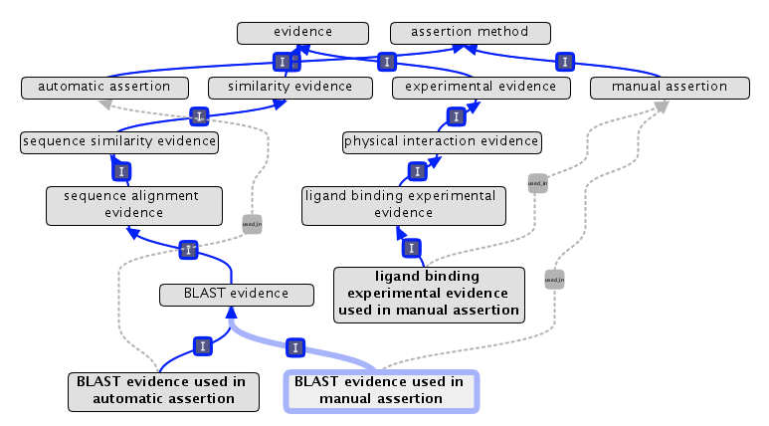
Assertion method & evidence root classes
Formerly GO “IEA”
used_in
OBO Format:
Intersection genus: BLAST evidence
Discriminating relations: used_in manual assertion

Slide 11
Modeling evidence: an update since ICBO 2011 (with some comments added)
Black magic?
For example, a GO term…
assertion source(external ontology or vocabulary)?
inference
conclusion
For example, a gene…
Where OBI fits in…
supports
about
inquiry (research, study, analysis, etc.)
evidence
(type of information)
assertion
(statement, annotation, etc.)
entity (thing, subject)
assertion method
(how assertion made)
EO class
evidence x assertion method
EO class
evidence – “a type of information that is used to support an assertion”
assertion method – “a means by which a statement is made about an entity”

Slide 12
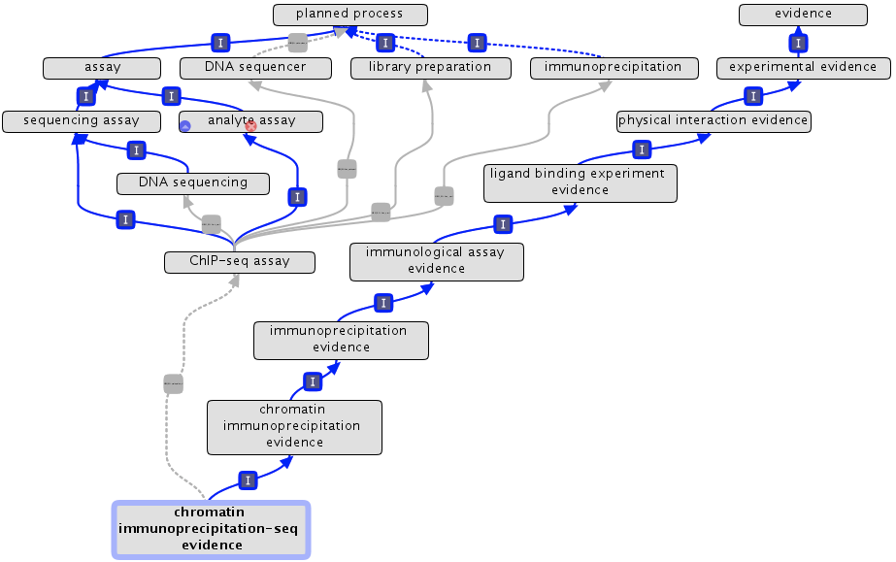
Evidence as specified output of OBI

Slide 13
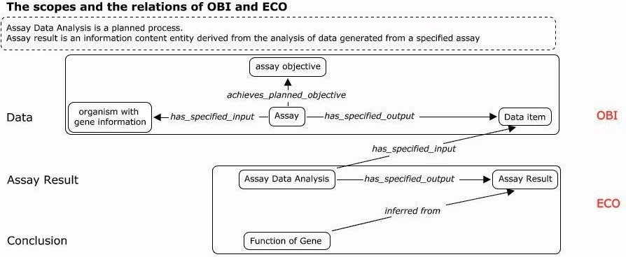
Philadelphia a couple of weeks ago…
Chris, Jie & Marcus met regarding evidence & phenotypes
Trying to model evidence and define scope of OBI & EO
Evidence (although not EO)

Slide 14
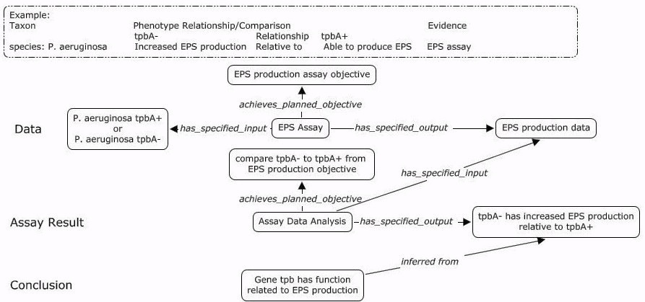
Example
Nice resolution…
but ECO must not change significantly or add complexity
Notes:
“The ontology model we discussed last Friday is focusing on how to distinguish the scope of OBI and ECO. In my understanding, it does not mean we will add those terms in the ontology and put complexity in ECO. Same to the statements we wrote. When we define output of OBI assay, they are some data or generally measurement data. However, ECO should be something (either result or conclusion) derived from the output defined in OBI assay by some analysis process rather than the output of OBI assay.” -- Jie

Slide 15
Some considerations (Chris Stoeckert)
1 - experimental evidence (ECO:0000006)
2 - evidence of metabolic process
3 - evidence of macromolecular biosynthesis
4 - evidence of polysaccharide biosynthesis
5 - evidence of EPS production
6 - evidence of increased EPS production
7 - (instance) tpbA- has increased EPS production relative to tbpA+
from GO
biological process
“Depending on the user, they may want high or low level types of evidence. These are not technology based but we can think about how to deal with that. …the next version we generate should be put in a form that addresses what users will see and make use of.” -- Chris
“ECO organizes terms based on assay, not GO… link the GO terms to OBI assay by adding biological identification objective. …ECO may organize terms either by assay or by biological identification objective.” -- Jie

Slide 16
Community needs - some recently introduced terms to map to OBI
Phylogenetic evidence
biological aspect of ancestor
biological aspect of descendant
phylogenetic determination of loss of key residues
rapid divergence from ancestral sequence
Transcriptional activation assay
localization of green fluorescent protein transcript
localization of LacZ transcript
Ligand binding experiment
enzyme-linked immunoabsorbent assay
bacterial one-hybrid assay
Transcript expression evidence
RNA-seq data
cap analysis of gene expression
nano-cap analysis of gene expression
Experimental phenotypic evidence
cleavage arrested development
cytochalasin experiment result
Others
systematic evolution of ligands by exponential amplification analysis
quantitative polymerase chain reaction
flow cytometry data
Phenotype annotation terms coming…

Slide 17
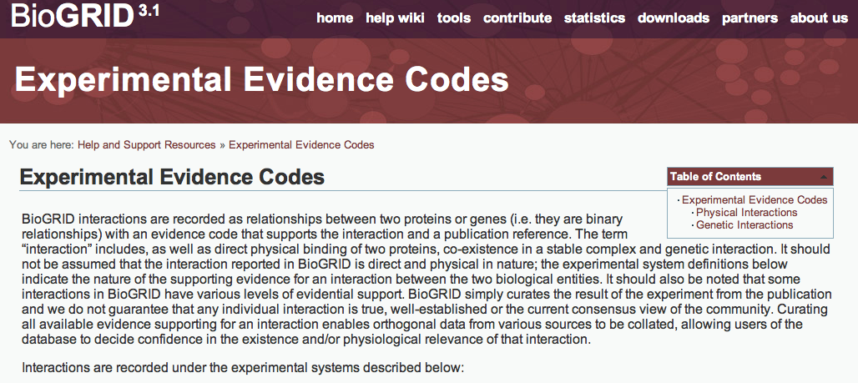
(Thanks to Midori Harris at PomBase)
Affinity Capture-Luminescence
Affinity Capture-MS
Affinity Capture-RNA
Affinity Capture-Western
Biochemical Activity
Co-crystal Structure
Co-fractionation
Co-localization
Co-purification
Far Western
FRET
PCA
Protein-peptide
Protein-RNA
Reconstituted Complex
Two-hybrid

Slide 18
General goals
Finish next major release of EO
100% terms defined
All terms named consistently (to reflect that they are “evidence”)
Push out website and first paper (both are nearing completion)
Complete mapping of EO
To OBI – use this to make EO cross products & identify co-development
To BioGRID
Further elucidate the steps from data to evidence
Consider “quality”
Black magic?
inference
conclusion
inquiry
evidence

Slide 19
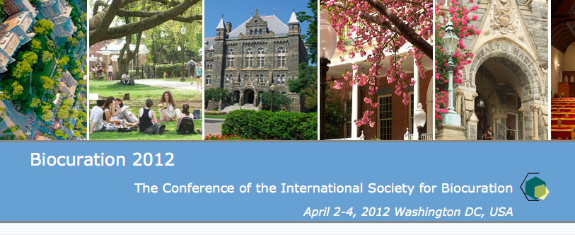
Quality codes
Pascale Gaudet email regarding Frederic Bastien
Upcoming workshop on “quality codes” at next Biocuration meeting
Information forthcoming…
Marcus is thinking of things like:
Two similar experiments, but one has more replication
Manually curated experimental data versus unreviewed algorithmic

Slide 20
Acknowledgements
Michelle Giglio for letting me run with this and Owen White for financial support
Bjoern, Philippe, Chris, Jie and the rest of OBI Consortium for awesome collaboration and insights
The GO Consortium for starting ECO and being agreeable to its future development
Midori Harris, Emily Dimmer, and others who actively seek ECO development by requesting terms and collaborating

